Slide 1

Midterm 3 – assignment 1
Autoencoders
shallow – deep – contractive – denoising – convolutional - randomized
Pasquali Alex

Slide 2
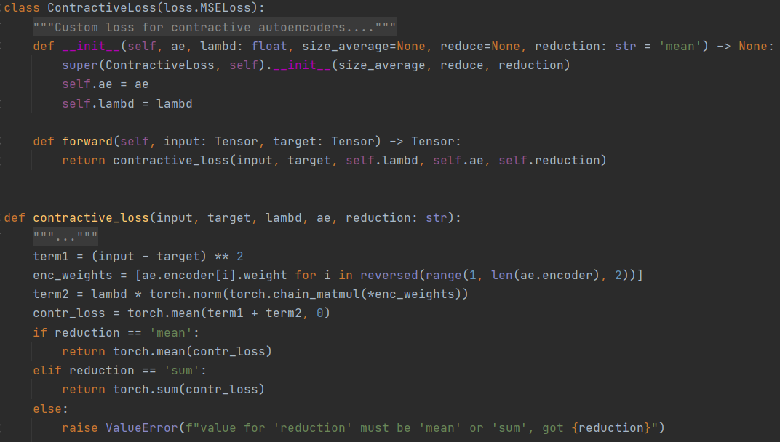
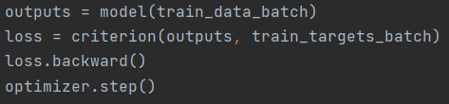
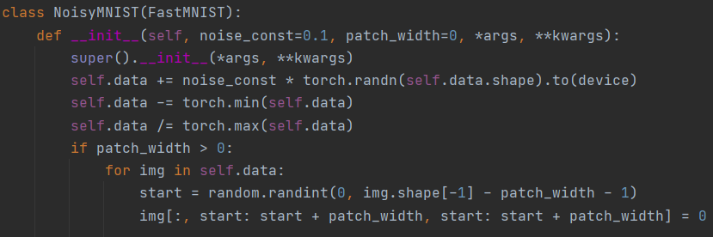
Contractive
Subclassed Pytorch’s MSELoss to use another function I created: contractive_loss
criterion = ContractiveLoss(…)
Use normally:
Denoising
Subclassed Pytorch’s MNIST dataset to load all data in GPU memory at once, to speed up performance.
Then create targets as a copy of data and add noise to the latter

Slide 3
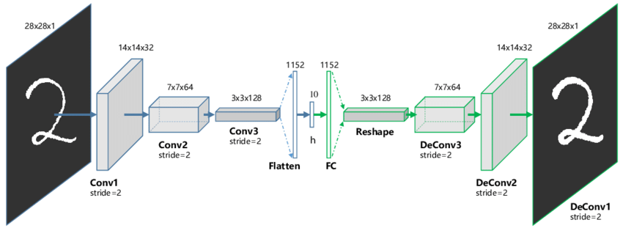
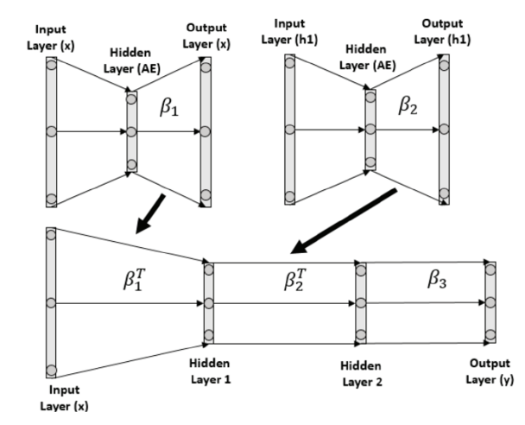
Convolutional
General architecture:
Conv layers with ReLU: keep same area, increasing number of filters
Max pooling (cause of the area reduction)
Fully connected layer in the center
Decoder: deconvolutions with decreasing number of filters to restore the original dimension
Randomized
For each layer of your deep randomized autoencoder:
Create a shallow AE with the latent dimension equal to the current layer’s one
Randomly initialize the weight matrices of encoder and decoder
Train shallow AE keeping encoder’s weights fixed
Copy decoder’s weights W_{d} in the correct layer of the deep decoder
Copy W_{d} transpose in the correct layer of the deep encoder

Slide 4
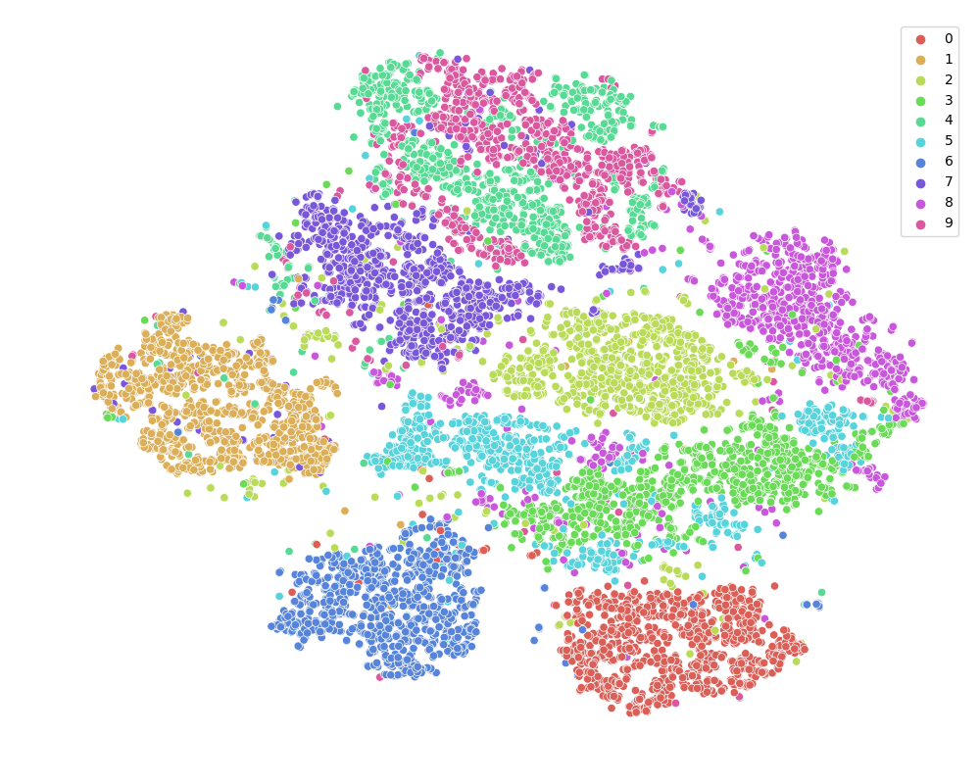
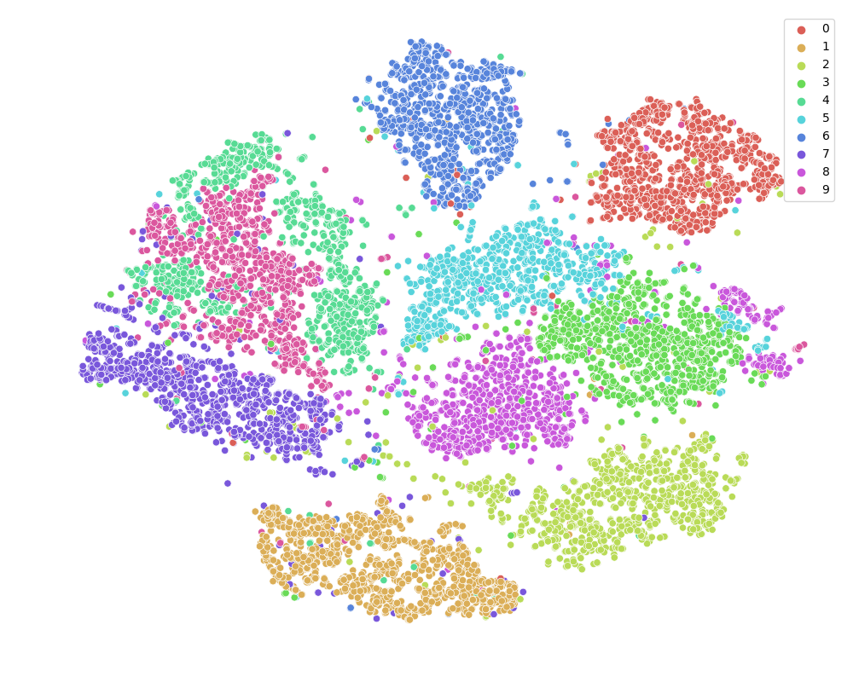
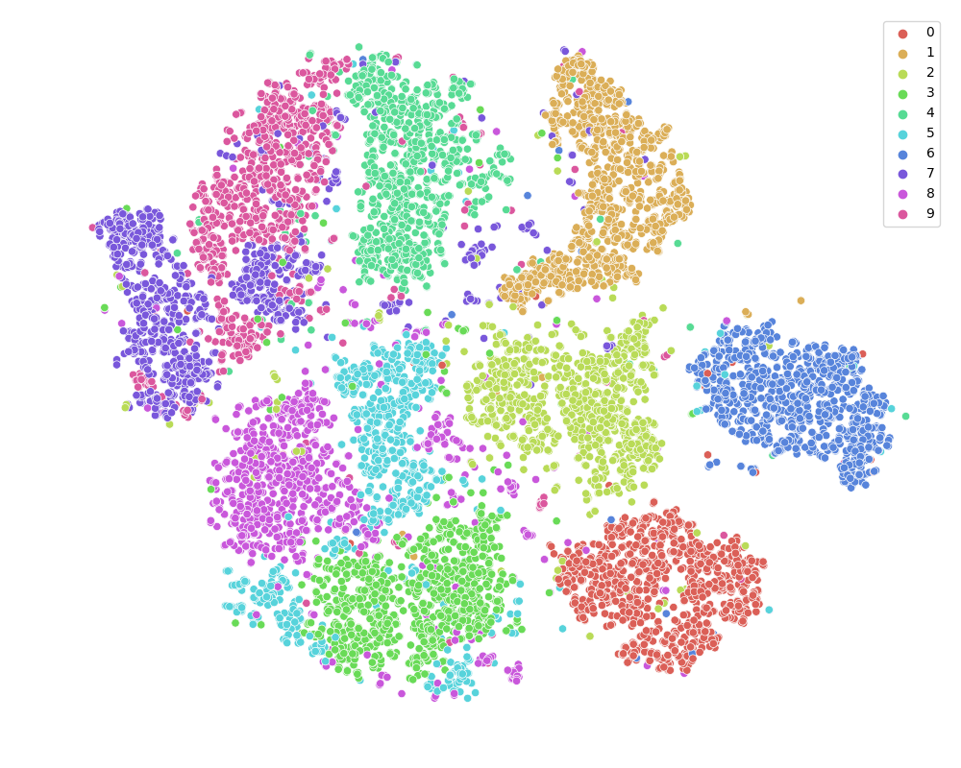
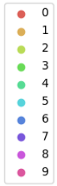
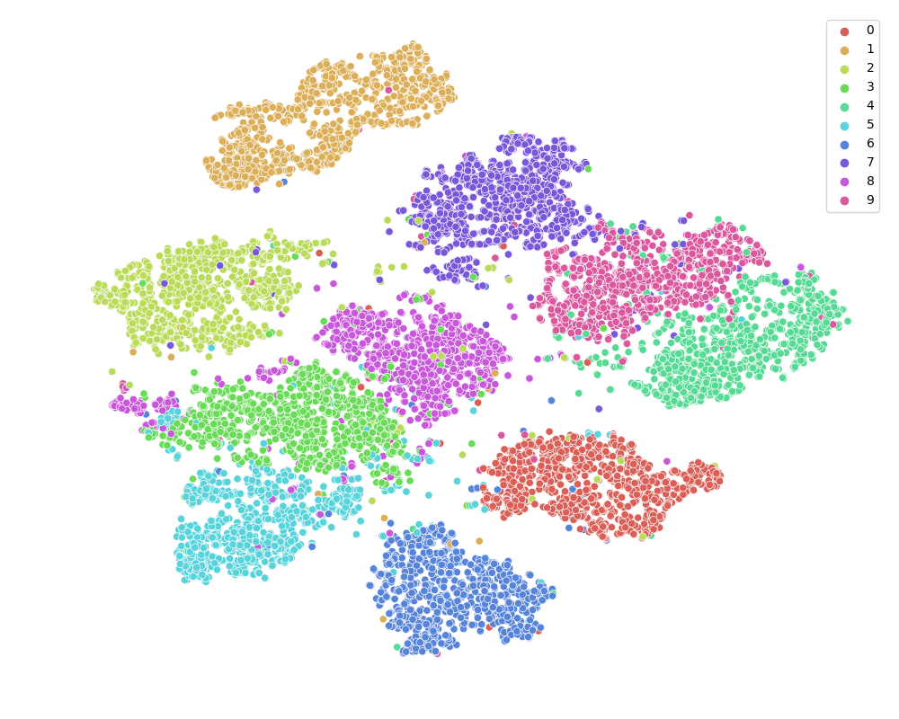
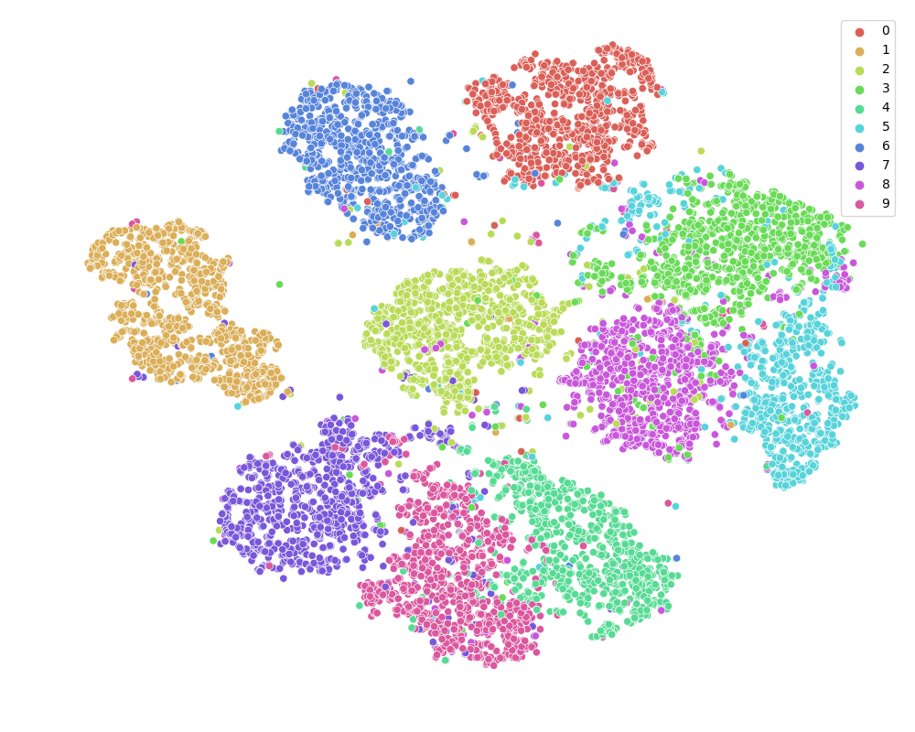
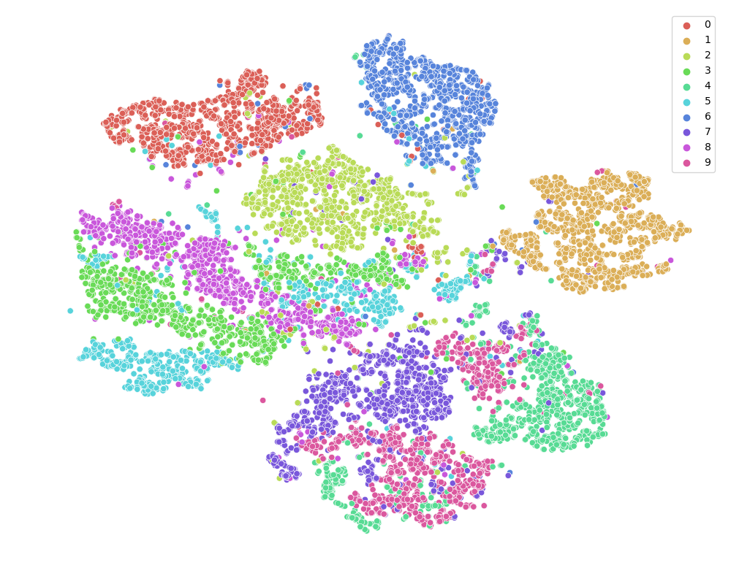
Std AEs
Basic
Contractive
Denoising
Shallow
Classification accuracy: 91,03%
Classification accuracy: 91,49%
Classification accuracy: 91,89%
Deep
Classification accuracy: 90,02%
Classification accuracy: 87,57%
Classification accuracy: 88,57%

Slide 5
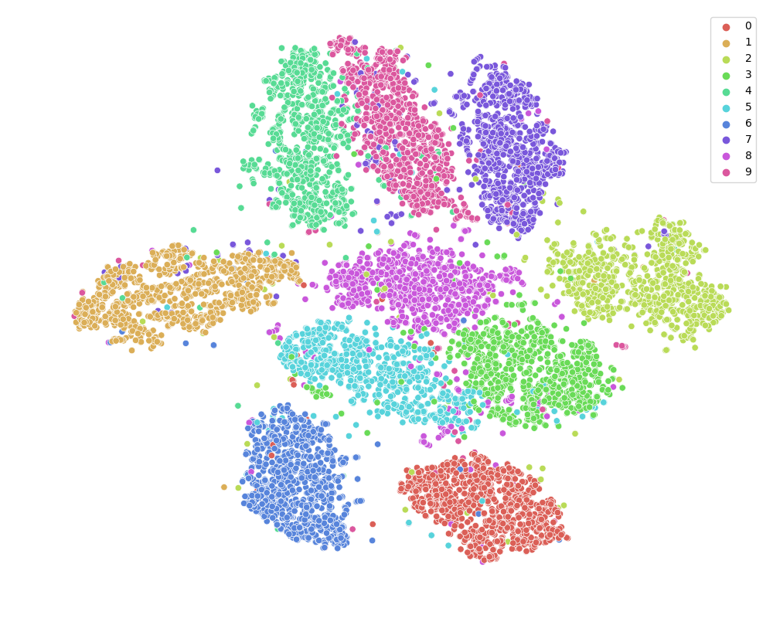
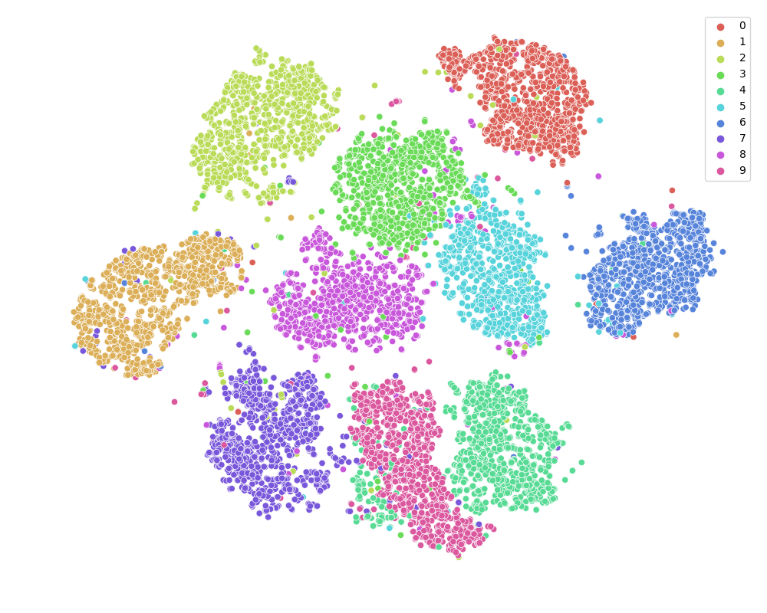
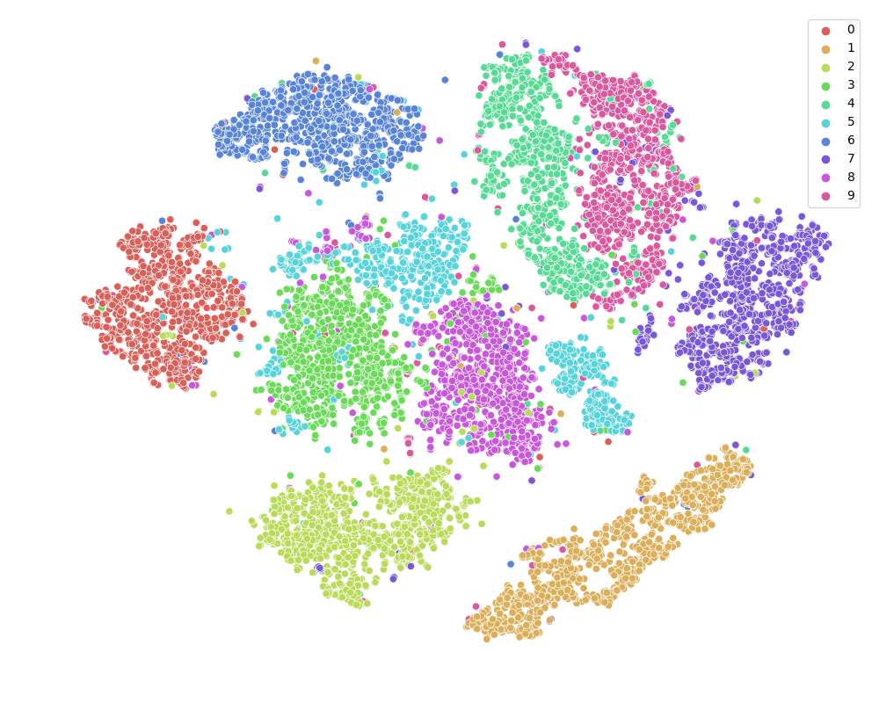
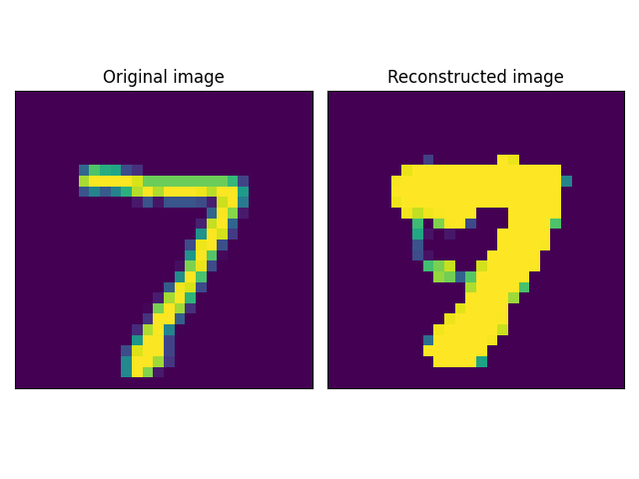
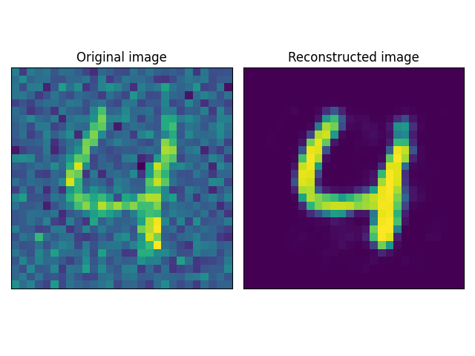
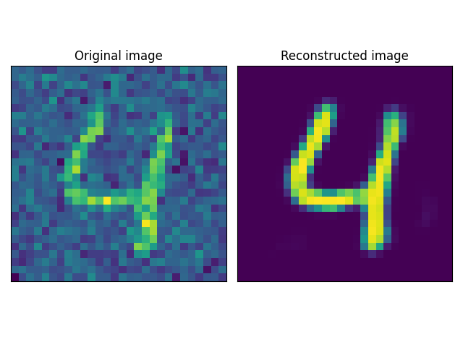
Shallow Conv
Deep Conv
Randomized
Basic
Classification accuracy: 91,11%
Classification accuracy: 92,73%
Denoising
Classification accuracy: 88,46%
Classification accuracy: 91,77%
Classification accuracy: 93,60%

Slide 6
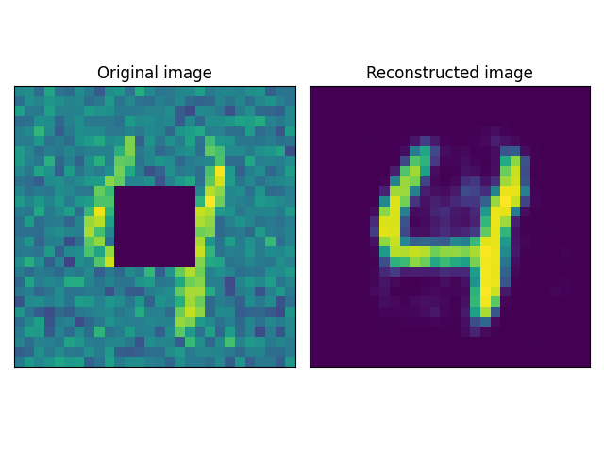
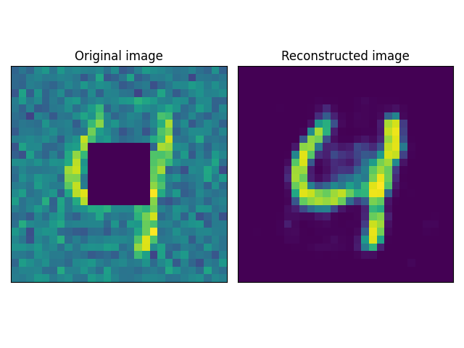
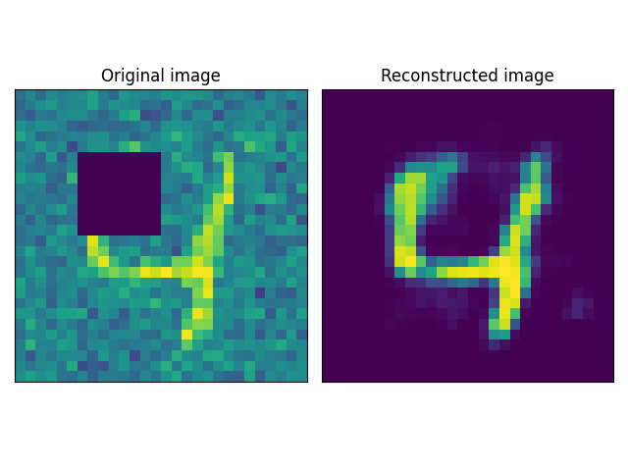
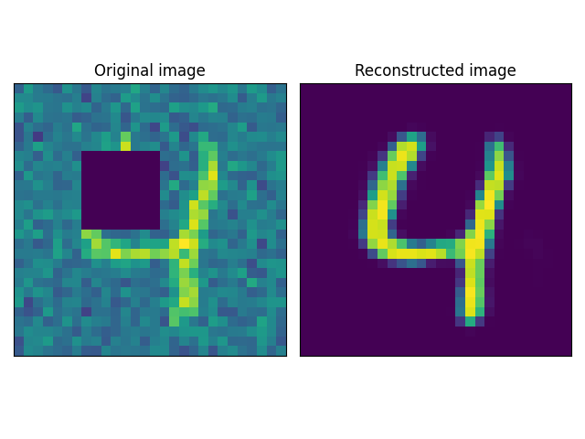
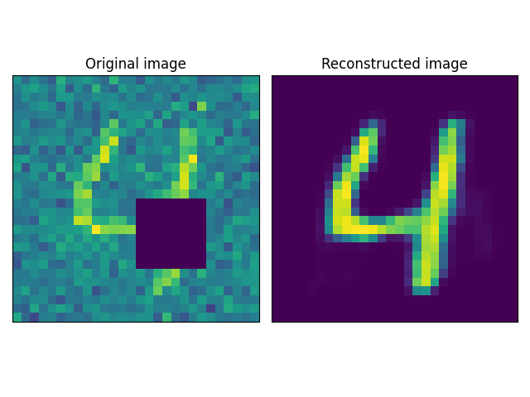
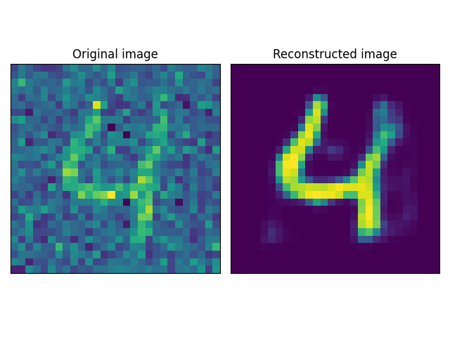
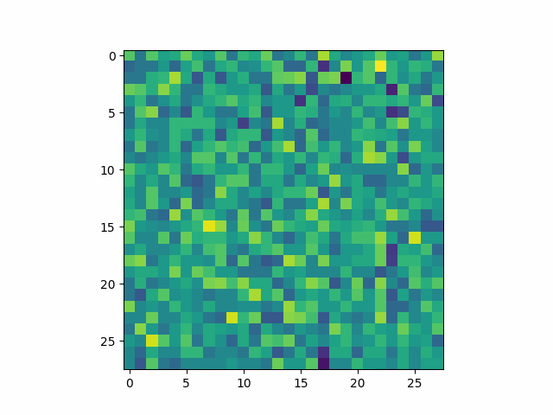
Image occlusion
Shallow Conv
Deep Conv
Better visualization if AE has smaller latent dimensionality.
This case:
deep contractive AE
(784, 500, 200, 100, 10)
Manifold convergence

Slide 7
Few observations
t-SNE plots and classification accuracy are pretty good, regardless of the models
Convolutional AE are only slightly better than standard AE
Probably due to the simplicity of the images in MNIST
However they reach good results way faster than standard AE (less epochs)
Still, they need more time to perform well on image occlusion
Possible future works
Wider training and testing of randomized AE
With noisy images
With image occlusion
Use denoising AE for image colorization
Echo State Networks for MNIST recognition _{(Schaetti et al., 2016)}

Slide 8
Thank you for your attention
Pasquali Alex

